Slide 1


Cyclistic : Cycle Share (Case Study)
K Srikar
5th June 2024

Slide 2
Objective of Study
How do Annual members and Casual Riders use Cyclistic Differently?

Slide 3
Breakdown of Plans Offered
Single-Ride Passes: Pass taken by Casual Riders for a single use.
Full Day Passes: Pass taken by Casual Riders for unlimited ride time in a single day
Annual Subscription: Taken by members who frequently use Cyclistic service

Slide 4
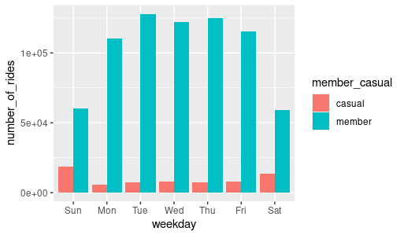
Number of Rides
The amount of rides taken by a Casual Rider and Member can be seen in the bar graph beside.
Frequency of use by members much greater that that of casual riders.

Slide 5
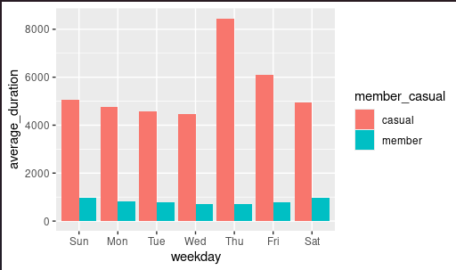
Duration of rides
We can see the comparison of ride times between casual riders and members in the bar chart beside.
Casual riders use the bike for longer duration compared to members

Slide 6
Insights
We can infer that members indeed use our service more frequently, this might be attributed them using bikes to commute to work.
Whereas casual riders use the service for longer hours in a single use, this maybe due to them going to places/trips on bikes

Slide 7
Conclusion/Takeaways
The need for casual riders to avail our subscription is not apparent due to the frequency of the use.
But they prefer to use our service incase they need to use bikes , showing that they like our service and might pay for it if we alter the plans a bit.
Possible fix, we can charge the bike rides per hour instead of ride use, introduce a discounted membership option for casual riders to avail service at lower cost and less frequency
Introduce membership plans exclusive to holiday season(potentially where casual riders use bikes the most)

Slide 8


References
Data was taken from DIVVY and the City of Chicago
Made open source by Data License Agreement.

